Slide 1
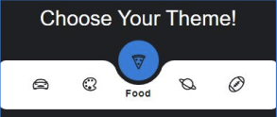



Memory Game
Clint Smith
Dalia Shaman
Martin Wisor

Slide 2


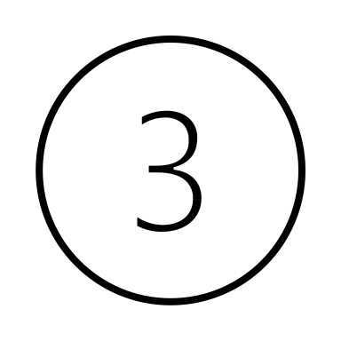


Table of Contents
Structuring the Project
Breakdown of Code
Lessons Learned/Challenges Faced
Additional Possible Features
Let’s Play!

Slide 3
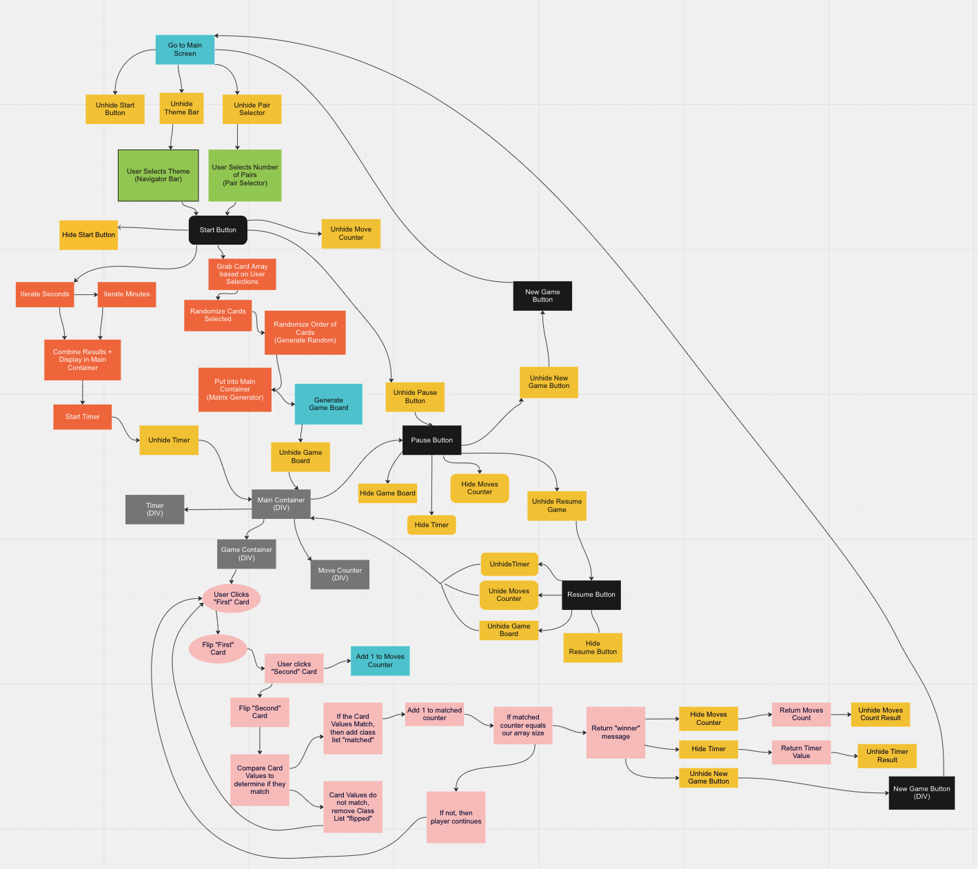
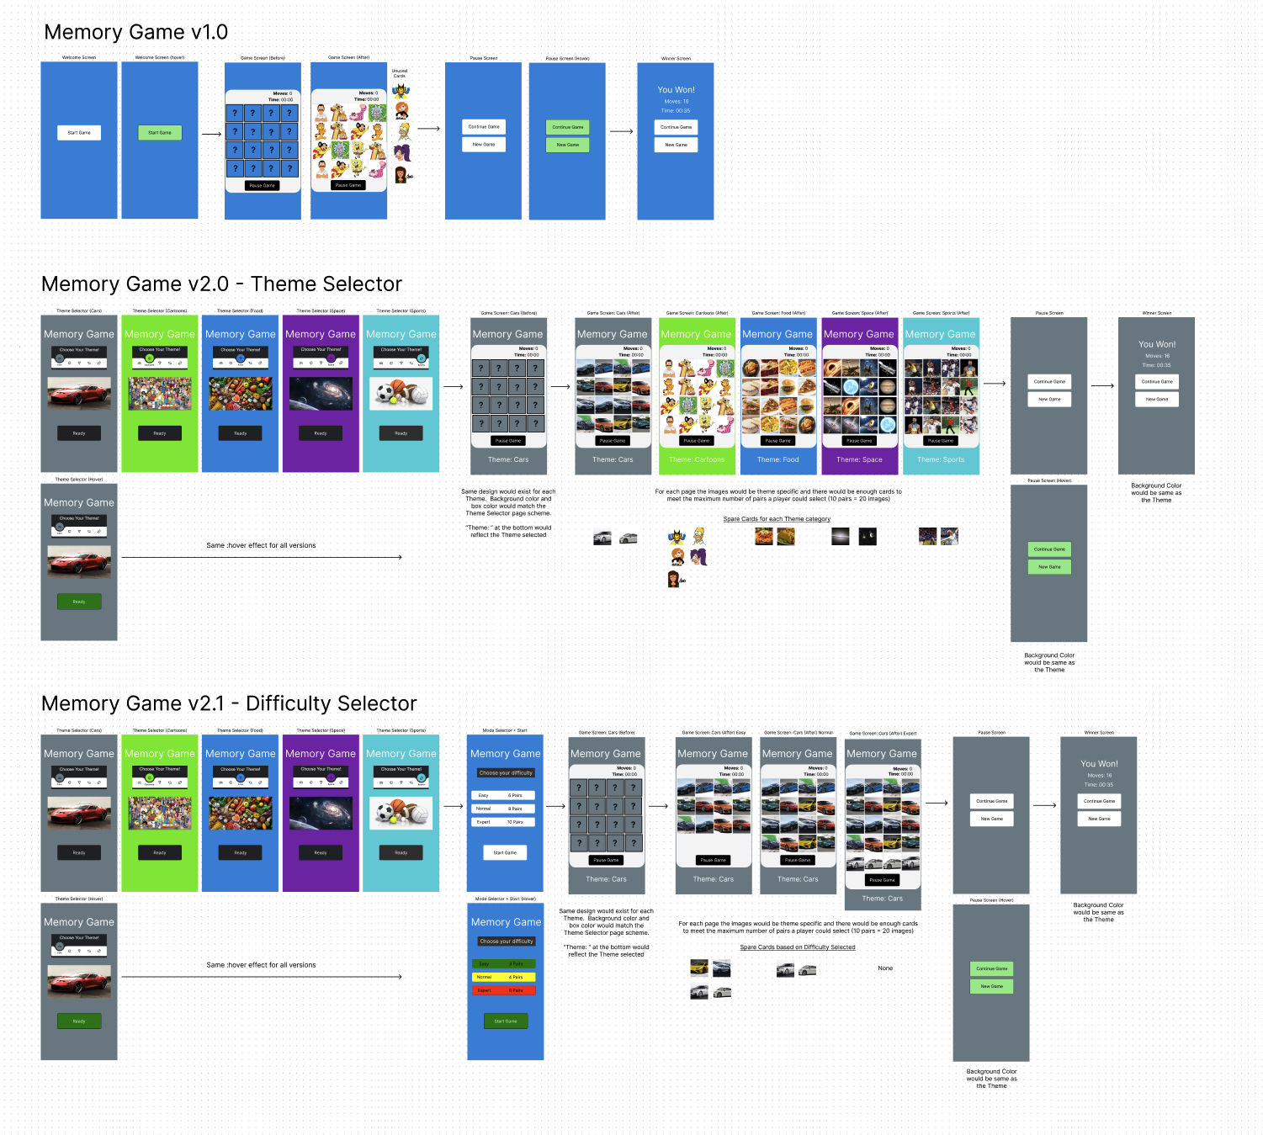
Structuring the Project
Tools used:
  Miro
  Figma

Slide 4

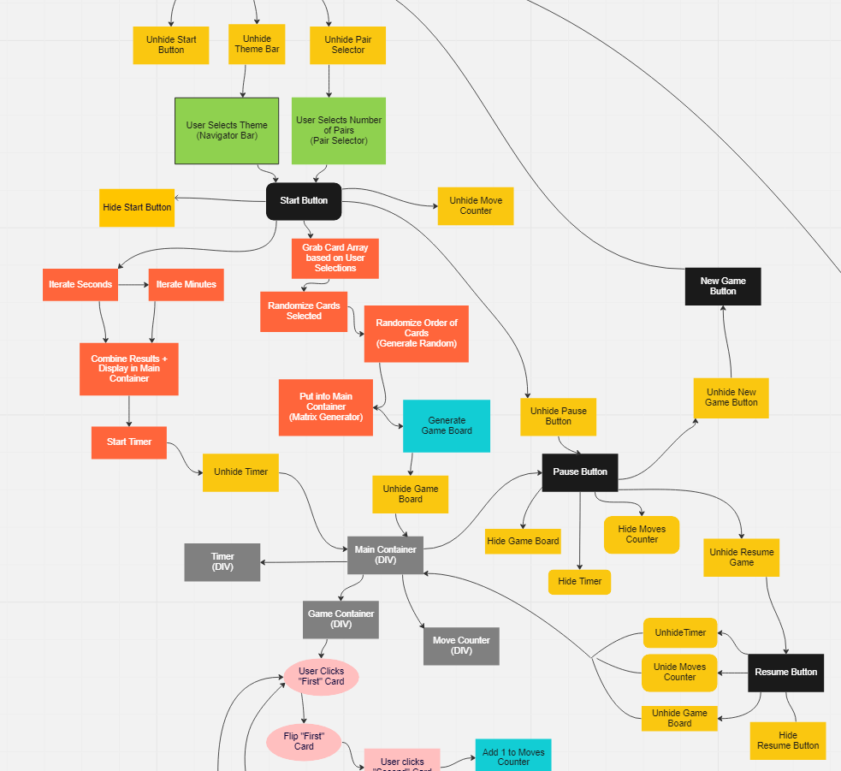
Structuring the Project
Miro
Break down the process + elements:
Buttons
Functions
Player Flow
Build Logic

Slide 5
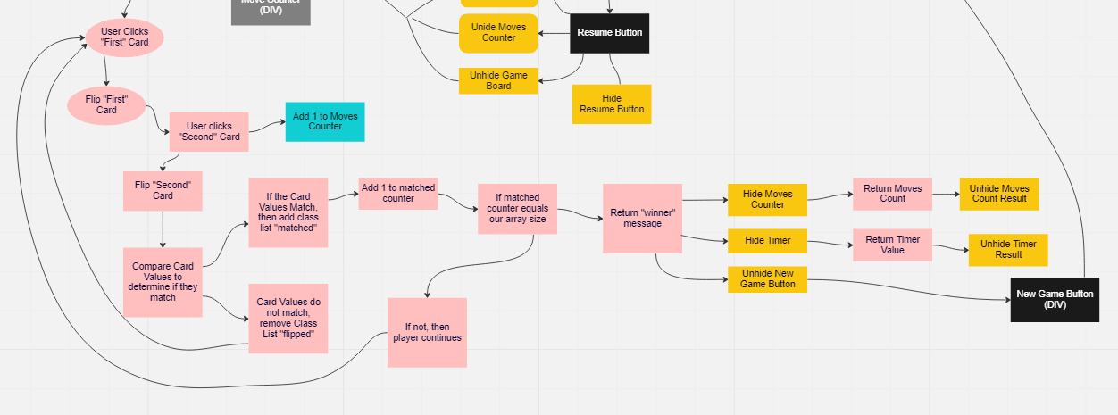
Structuring the Project
Miro
Break down the process + elements:
Buttons
Functions
Player Flow
Build Logic

Slide 6
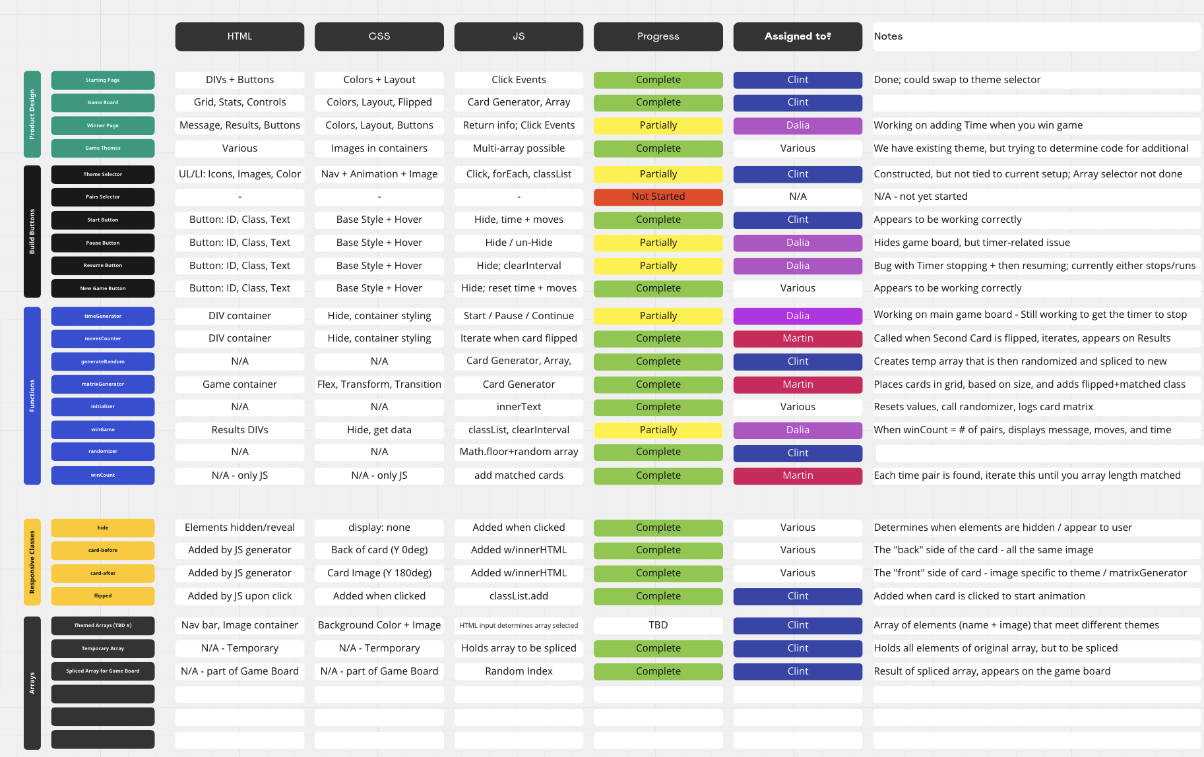
BREAKDOWN OF CODE
Miro
Used a spreadsheet-like template to divide up tasks to tackle the project
Product design, build buttons, functionality, responsive classes, arrays

Slide 7
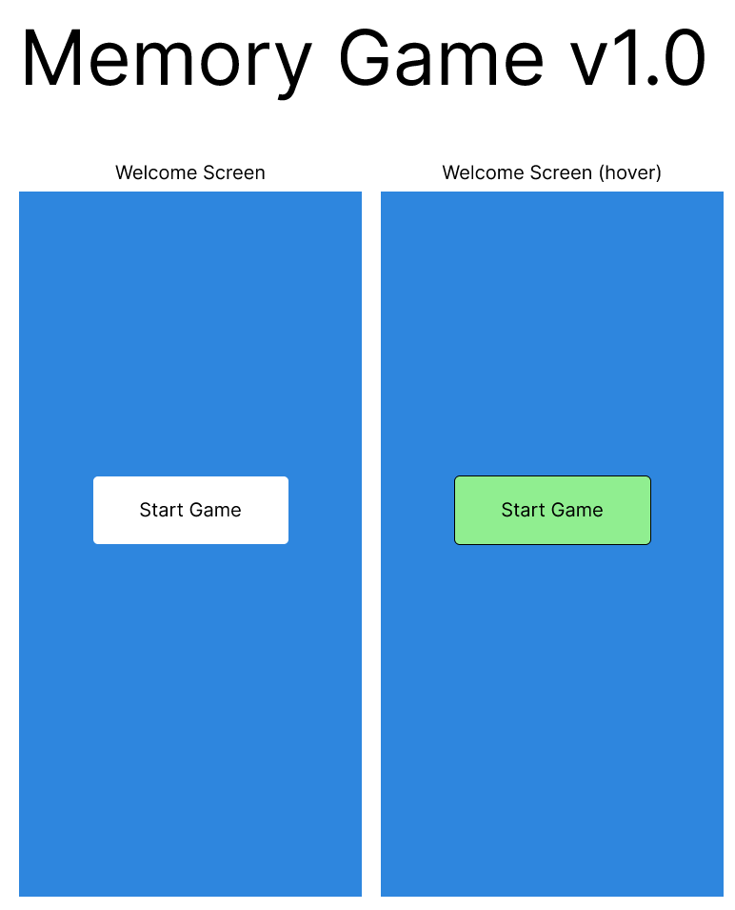
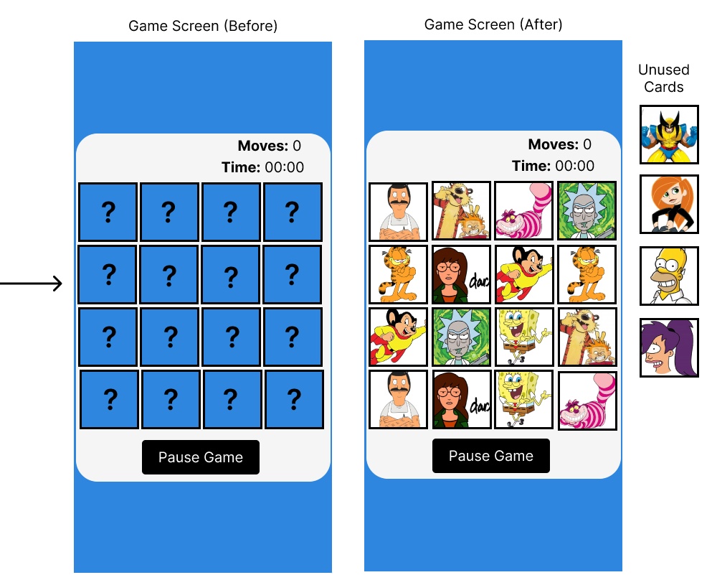

Slide 8
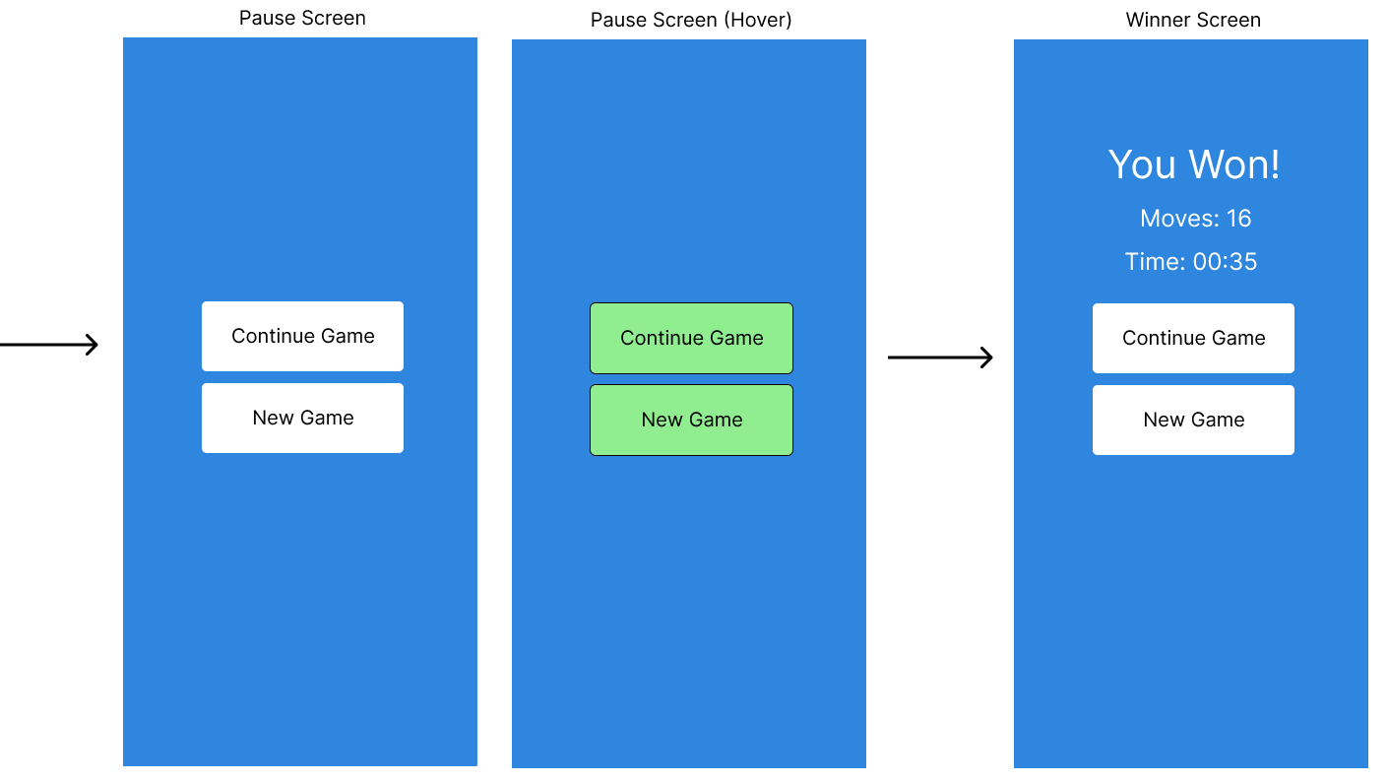

Slide 9
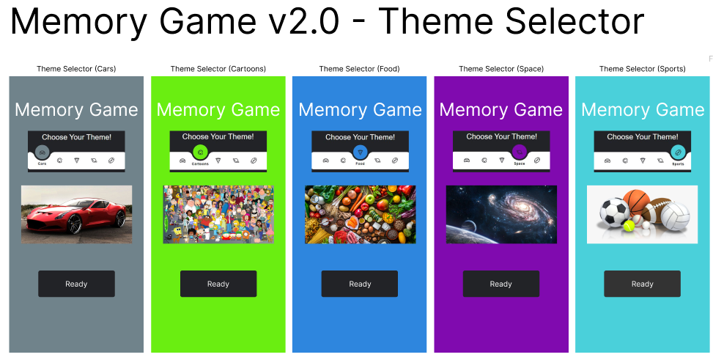
Additional possible features

Slide 10
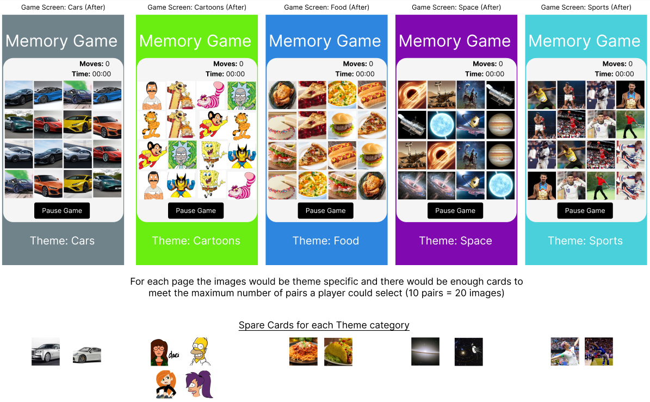

Slide 11
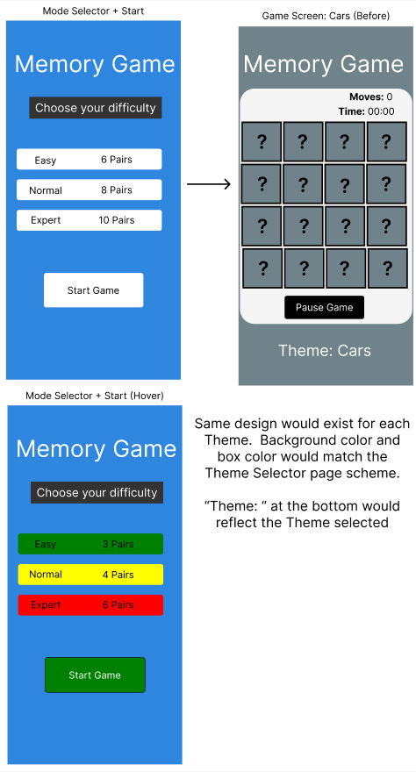
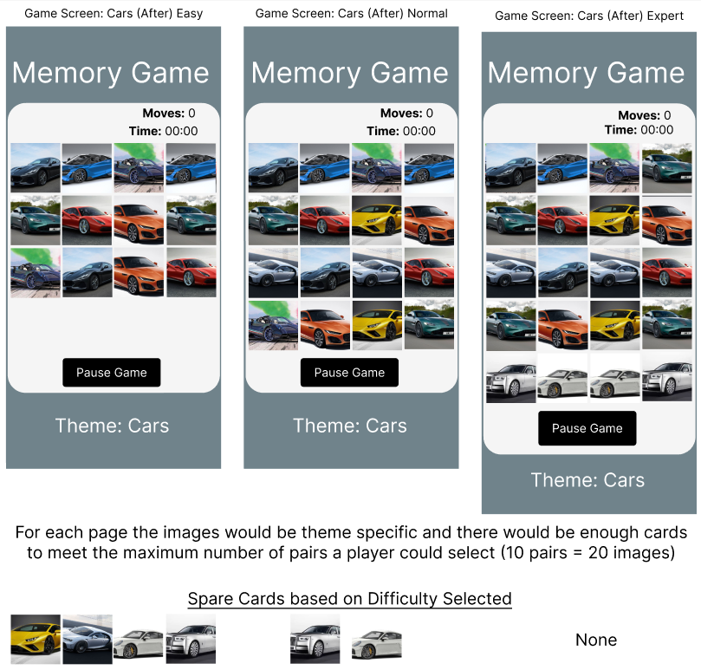

Slide 12

What we each learned and the challenges we faced

Slide 13
Let’s Play!
GitHub

